Slide 1
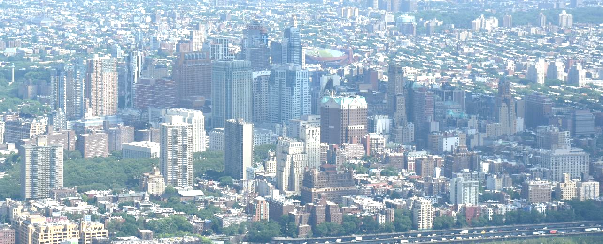
The Search for Decent Housing in Brooklyn
By: Mona Berdugo

Slide 2

The Problem:
Young couple
Small children
Limited budget
Looking for home in
Brooklyn, NY

Slide 3

Criteria
1. Parks and outdoor
Spaces for family
outings
and fun

Slide 4
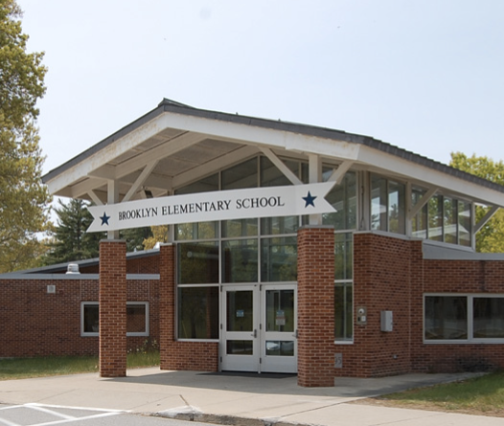
2. Variety of schools to provide options and ensure other young families

Slide 5
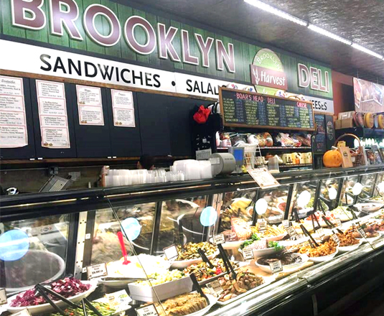
3. Variety of groceries, supermarkets and other food and drink shops for convenience

Slide 6
Data Sources
Geographic data: https://cf-courses-data.s3.us.cloud-object-storage.appdomain.cloud/IBMDeveloperSkillsNetwork-DS0701EN-SkillsNetwork/labs/newyork_data.json.
A geojson of New York neighborhoods: https://data.cityofnewyork.us/City-Government/Neighborhood-Tabulation-Areas-NTA-/cpf4-rkhq
Cost of housing in Brooklyn: https://www.propertyshark.com/mason/market-trends/residential/nyc/brooklyn/brooklyn-heights
I got information about schools, parks and shops: Foursquare API

Slide 7
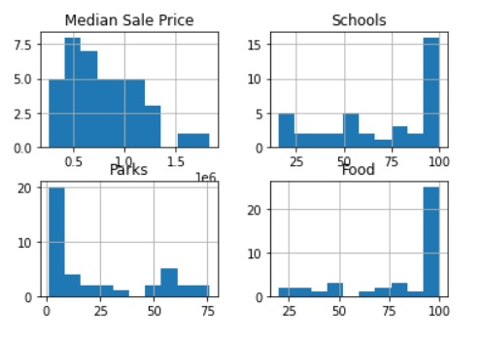
Methodology:
Histograms:
Houses range from $250,000 - $1,800,000
Most homes in $500,000 range
Most neighborhoods have lots of schools and food shops
Outdoor spaces are harder to come by.

Slide 8
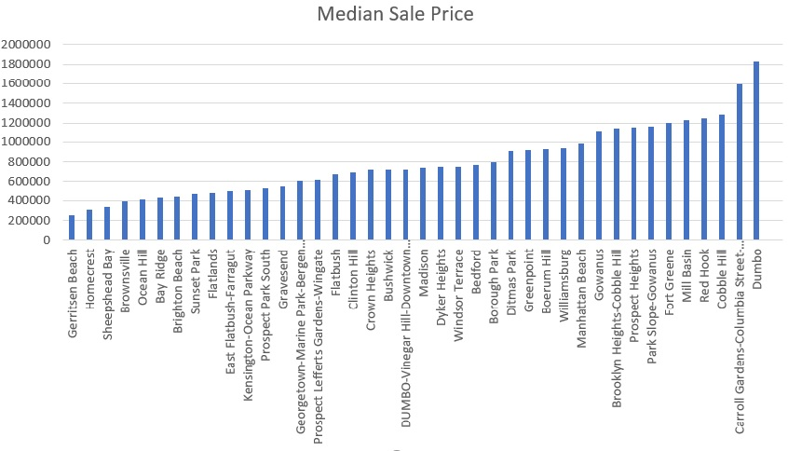
Prices in ascending order by neighborhood

Slide 9
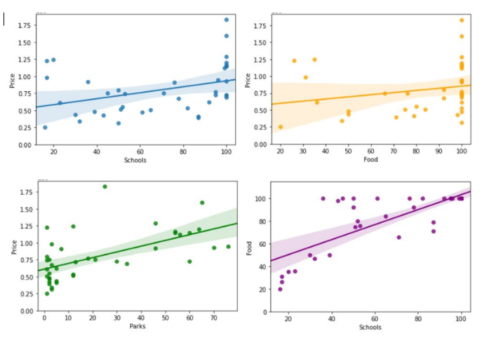
Regression Plots
Small, if any, correlation between schools/food shops and prices.
Variety of schools across all prices.
Large variety of food shops mostly in expensive neighborhoods but also in others.
Few parks in cheap areas. More in more expensive ones.

Slide 10
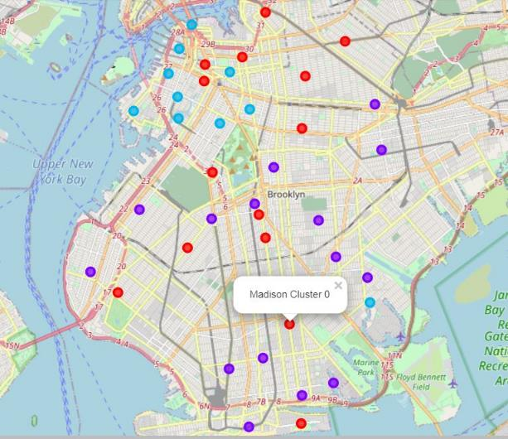
K-means Clustering
Cluster 0 – Red: Mid-range prices, avg of 90 food places, 74 schools and 25 parks per neighborhood.
Cluster 1 – Purple: Cheapest. But fewest schools, parks, and food.
Cluster 2 – Lt blue: Most expensive, with many schools, parks and food shops.

Slide 11
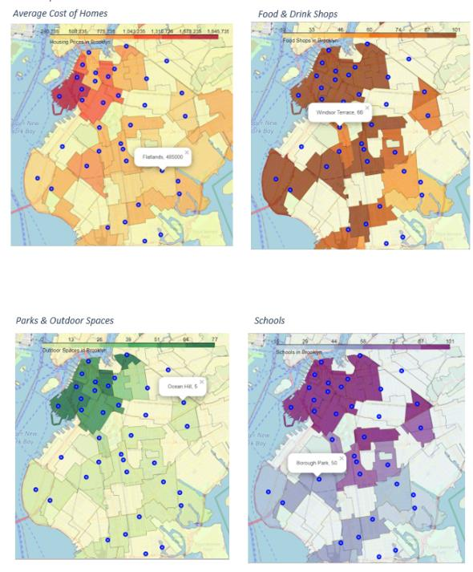
Choropleth maps
Neighborhoods with highest concentrations of desired attributes are in the northern part of borough.
Prices in norther section are midrange to expensive.

Slide 12
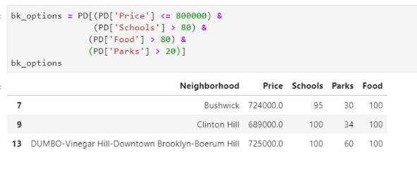
Final Search:
There are three neighborhoods that are:
Under $800,000
More than 80 schools
More than 80 Food shops
More than 20 parks and recreational areas.

